Slide 1
Memphis/Shelby county Homeless consortium
DATA QUALITY PLAN

Slide 2
What is data Quality?
Data quality refers to the integrity of the information entered into a given system. For the purposes of this guide, the system is the Homeless Management Information System (HMIS) utilized by the Memphis/Shelby County community.
Evaluating the integrity of the HMIS is based on measures associated with Timeliness, Completeness, Accuracy, and Consistency.
These measures helps explain how usable and and trustworthy the data collected in HMIS is when it comes to open reporting periods or making decisions around how and where to direct system wide interventions.

Slide 3
Long-term Goals of data quality
Participation in the Data Quality plan will eventually factor into the CoC’s annual Rank and review process.
Bolstered participation form programs not required to enter into HMIS
Improved monthly/quarterly reports concerning enrollment/exits and system performance measures.
Creation of a data quality subcommittee to support the HMIS Committee.

Slide 4
Process for adopting data quality plan
This plan is an expansion of the Data Quality tenets agreed to in the Agency HMIS Agreements, which are signed annually.
In the coming months, the HMIS committee will adopt a rubric off which to score non-compliance with the current data quality plan.
Beginning October of 2022, after the HMIS Committee has approved of the Data Quality measures and rubric in place, a data quality score will be factored into the CoC’s Rank and Review process.

Slide 5
Roles and Responsibilities
CAFTH - Community Alliance for the Homeless is both the lead CoC agency and lead HMIS agency in Memphis/Shelby County. CAFTH’s HMIS team is responsible for executing the Data Quality plan, meaning program monitoring and broad oversight concerns.
HMIS COMMITTEE - The HMIS Committee will be responsible for supporting the long-term planning goals associated with the Data Quality plan, including, but not limited to, the creation of a Data Quality subcommittee or other ad hoc entity, and training/improving participation from agencies that utilize HMIS.
PROGRAM STAFF (CoC and ESG-Funded Service Providers) - CoC and ESG-Funded Service Providers – Any service providers receiving funding through CoC or ESG, and are therefore required to enter into HMIS, must participate in the monitoring procedures of the Data Quality plan, including, but not limited to, identifying a point-of-contact or HMIS lead, who will regularly confirm program roster numbers, bed/unit inventory, and address any assessments not up to date.

Slide 6
Components
Households with More than One HoH – Enrollments are only allowed to have one, and only one, head of household (HoH) from project start to project end.
DoB After Project Start – Date of Birth (DoB) of client is after the project start date, more than likely indicating an incorrect date of birth.
Move-in Dates – A housing move-in date is required for any permanent housing project (RRH/PSH) that sees a client move into housing. However, this date does not necessarily coincide with the project start date; this metric ensures the move-in date is not entered before or after the project start/exit date.
Annual Assessments Past Due – An annual assessment may be completed either 30 days prior to or 30 days after the client’s program anniversary date (on a yearly basis). This metric indicates when an assessment has not been completed 30 days after the client’s anniversary date.
Program Availability – This is not a metric that comes with known right or wrong. This simply shows the number of clients enrolled in a program and therein the number of beds (if needed) that are taken/available. HMIS admins will confirm these numbers are accurate with the help of Program Staff on a routine basis.

Slide 7
Monitoring
A data quality dashboard has been created using Looker, our Clarity visualization software for custom reporting. This Looker dashboard is accessible via the Reports tab in Clarity.
At the end of the month, the HMIS Admin team will reach out to designated Program Staff to confirm program availability is up to do date and to confer on any data concerns out of compliance (e.g. missing assessments, incorrect move-in dates).
Program Staff will then have the next month to correct any data concerns.

Slide 8
Resolving Data concerns
If at the end of the month the same data concerns have not been resolved (same unique ID is impacted in the same way), the agency will receive a negative mark that will eventually impact their Rank and Review score.
If data concerns are in compliance at the end of the month, Program Staff will receive a positive mark and no points will be deducted.
If after two months the same data concerns have not been resolved, the agency will receive another negative mark and be subject to a retraining on HMIS. Again, the goal is improved data quality for all --- not to create a punitive system. If there are repeat issues with data quality, HMIS Admin are here as resources.
HMIS Admin will track yearly compliance internally and report it quarterly, but Program Staff may request a record of their data quality concerns at any time.

Slide 9
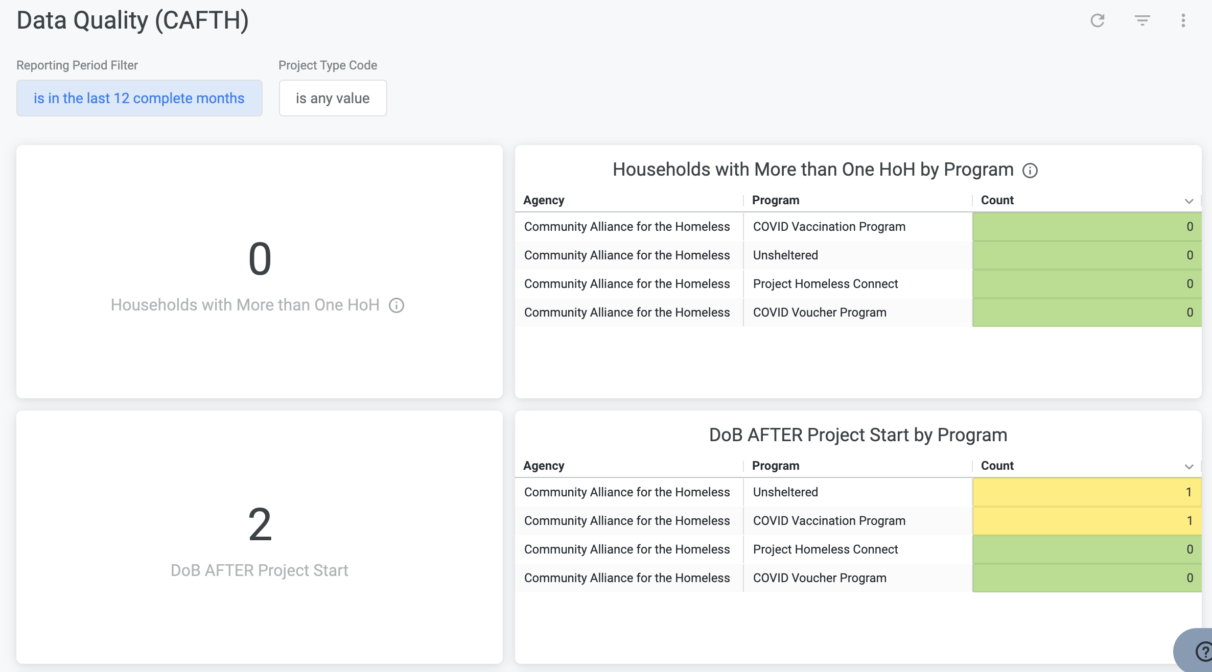
data quality dashboard

Slide 10
contact information
Kiarra Fortney
Hmis Administrator
Email: Kiarra@cafth.org
Phone: 901-268-2451 (Please leave a message if call is missed)

