Slide 1
Data Analysis and Reporting
Memphis

Slide 2
Agenda
Importance of Data
Access to Data
Report Library
Client-level Reports
Data Analysis Tools
How to Request Data

Slide 3
Importance of Data

Slide 4
Why is Data Important?
Tell your community’s story
Evaluate performance and outcomes
Improve Data Quality
Identify gaps in services and programming
Data-informed decision-making
Funding

Slide 5
What Data do you have access to?

Slide 6
What data do you have access to?
Everything in Clarity can be analyzed
Available through:
Report Library
Client-level Reports
Data Analysis

Slide 7
Report library

Slide 8
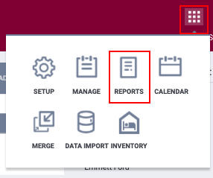
Report Library
Contains all Bitfocus-maintained reports
To access the Report Library, click the Reports icon from the Launchpad.
The Report Library contains sections for each report category.

Slide 9
Report Library Sections
Agency Management
Agency Specific
Assessment Based Reports
Community and Referrals
Data Quality Reports
Housing
HUD Reports
Program Based Reports
Service Based Reports
Administrator Reports

Slide 10
Report Library
Badges give you a visual indicator of the status of the report.
*Please consider the report status when reviewing the data populating the report.
Badges

Slide 11
Report Library
Favorites
Schedule
More Info
Features

Slide 12
Reports Library- Useful Favorites
[GNRL-106] Program Roster report-lists program stay information for selected programs
OUTS-106] Client Demographics- Provides client demographic details for selected program
[HUDX-225] HMIS Data Quality Report- reviews data quality across a number of HMIS data elements
[GNRL-104] Service Summary-provides service counts and the number of unique clients who received selected services

Slide 13
Client-Level Reports

Slide 14
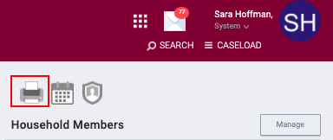
Client Reports
Pull data on a specific client record
To access Client Reports, click the printer icon in the client record
Access depends on your access role, agency, and additional agency access

Slide 15
Client Reports
Case Notes
Client History
Profile Screen
Client Appointments
Client Service Notes
Client Enrollment Details
Homeless Status Timeline Report
Client Summary
Client-Level System User & Length of Time Homeless Report

Slide 16
Client Reports
More Info
Schedule
Features

Slide 17
Client Reports- Useful Report
[CLNT-127] Homeless Status Timeline Report- provides a graphical representation of a client's timeline of HMIS enrollments, indicating a client’s homelessness or housed status.
[HUDX-233] Client-Level System Use & Length of Time Homeless Report- provides a general summary of information in an individual client’s HMIS history that is relevant to chronic homelessness.
[CLNT-125] Client Summary- provides an overview of the client's history in the system.

Slide 18
Data analysis tools/custom repots

Slide 19
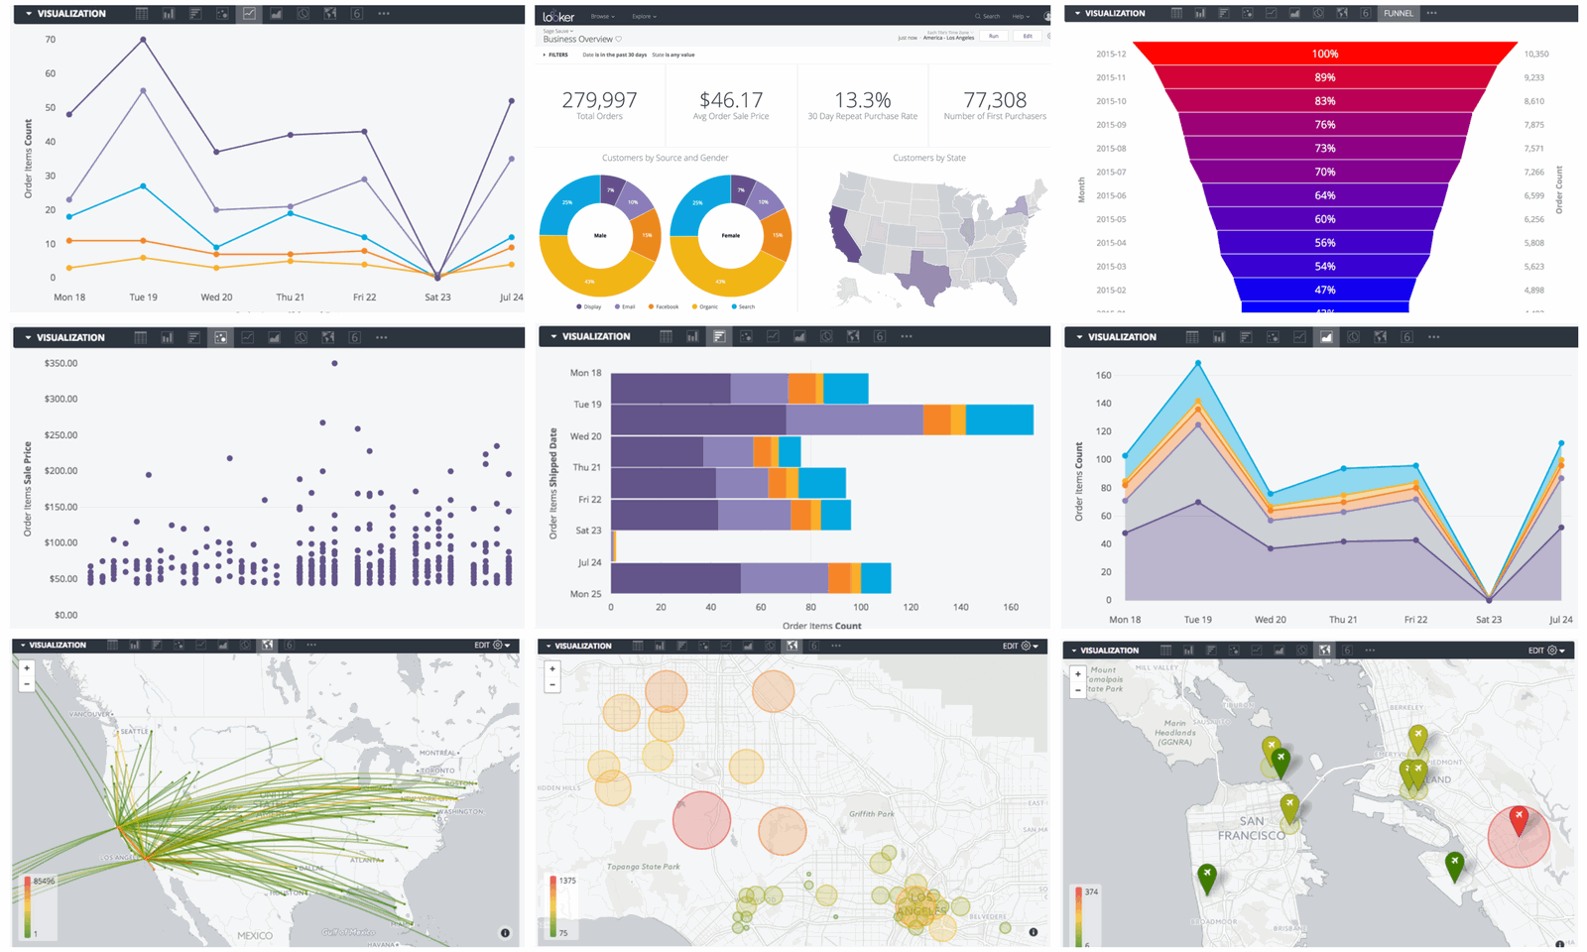
Clarity Human Service Data Analysis Tool
Data analysis and visualization platform
Allow communities to create custom reports and dashboards
Pulled from data entered in Clarity Human Services
Provide data using visualizations

Slide 20
Data Models
Client Model
The Client Model contains all client records.
Designed to work with Coordinated Entry functionality. Clients must have an assessment in order to be included.
Data Quality
Based on project enrollments and provides easy-to-use calculations of data quality for all HUD HMIS data elements
HMIS Performance
Clients must have a project enrollment for their data to be included.
HMIS Population Over Time
Allow users to conduct longitudinal analyses. Clients must have a project enrollment for their data to be included.
Project Descriptor Model
Services Model
Coordinated Entry
Contains information about system settings and agency, project, and service configurations.
Reports on client services that have been entered.

Slide 21
Accessing Reports
User Interface
Embedded reports can be accessed by navigating to the Report Library icon.

Slide 22
Data Analysis Sections
Built-in Reports
Memphis System Reports
Agency Specific Report
Pre-programmed reports and dashboards
LSA data clean up dashboards
Reports specific to Memphis’ instance of Clarity
Agency manager reports, data quality, and youth reports
Custom reports created for a specific agency

Slide 23
Manipulating Reports
Built-in and Memphis System reports are created based on CoC information
Dashboard filters may already be included on the dashboard
Simple filters can be used to search for agency or program specific information
Only users with data analysis: save can save the report after editing
Data Analysis Tools

Slide 24
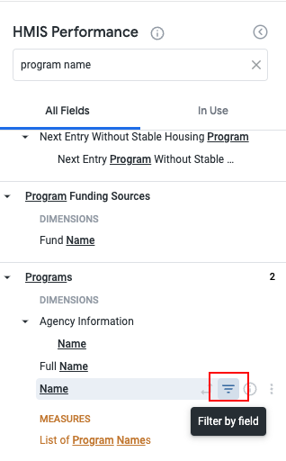
Manipulating Reports
Search for the field name
Pay attention to the sections when selecting the field
Add a filter by clicking the filter icon
Specify info in the filter

Slide 25
Manipulating Dashboards
Click to edit dashboard
Edit individual Look
Follow steps for manipulating reports

Slide 26
Requesting custom reports

Slide 27
Questions to Ask Before Requesting a Report
What are the local, state, and federal reporting requirements?
What questions are you trying to answer?
What do you want to measure and why?
What decision will be made based on this data?
How data savvy is the audience?
What visualizations are needed?

Slide 28
Report Request Process
Send a report request to the Help Desk helpdesk@cafth.org
If possible, include details about the report:
Why is the data needed? (what question are you trying to solve with the data)
Agency name
Program name (program(s) you want to pull data from)
Reporting date range
Sub-population? (vets, youth only, families only, etc.)

Slide 29
Questions?

