Slide 1
APR Training
Understanding the APR
Confidential and Proprietary | © 2022 Bitfocus Inc., All Rights Reserved

Slide 2
Objective
To provide information regarding the importance and usefulness of the HUD Annual Performance Report (APR) as part of program evaluation and improvement.
Confidential and Proprietary | © 2022 Bitfocus Inc., All Rights Reserved

Slide 3
Agenda
Welcome and Introduction
APR: Why We Do It
APR Requirements
Generating the APR
APR Data Elements
Questions and Comments
Confidential and Proprietary | © 2022 Bitfocus Inc., All Rights Reserved

Slide 4
APR: Why We Do It
Confidential and Proprietary | © 2022 Bitfocus Inc., All Rights Reserved

Slide 5
Why the APR Matters
APR = Housing & Urban Development (HUD) Continuum of Care (CoC) Annual Performance Report
Updated regularly to align with HUD Data Standards
Comprehensive view of the program’s client data and outcomes
Required to be submitted by direct recipients of HUD CoC funding
Utilize the online Sage Reporting Repository to submit
Confidential and Proprietary | © 2022 Bitfocus Inc., All Rights Reserved

Slide 6
Why the APR Matters
This report can help answer key program evaluation and improvement questions:
Who have we served, and for how long?
What has changed for the people we served?
What data are we missing?
Confidential and Proprietary | © 2022 Bitfocus Inc., All Rights Reserved

Slide 7
APR Requirements
Confidential and Proprietary | © 2022 Bitfocus Inc., All Rights Reserved

Slide 8
APR Requirements
Sage Account
Users can create an account on their own
Request is sent to the CoC’s primary contact for approval
Coordinate internally to decide who submits the APR
HMIS System Account
Connect with your agency lead or HMIS admin
Confidential and Proprietary | © 2022 Bitfocus Inc., All Rights Reserved

Slide 9
APR Requirements
Enrollments
At enrollment collect and enter as much accurate information as possible
Annual Assessments
Confirm and update any changes or new health, income, benefit, and insurance information
Status Assessments do not replace Annual Assessments!
Exits
At exit, the exit destination is a key field in your APR as is ensuring that health, income, benefit, and insurance information is up-to-date
Confidential and Proprietary | © 2022 Bitfocus Inc., All Rights Reserved

Slide 10
APR Data Elements
Confidential and Proprietary | © 2022 Bitfocus Inc., All Rights Reserved

Slide 11
APR Data Elements: Reports
Run program and data quality regularly to prepare for your APR submission
[GNRL 106] Program Roster
[HUDX-227] Annual Performance Report [FY 2020]
[HUDX-225] HMIS Data Quality Report
Confidential and Proprietary | © 2022 Bitfocus Inc., All Rights Reserved

Slide 12
Program Roster
[GNRL-106] Program Roster (Program Based Report)
Who’s stayed in the program
Lists program stay information for clients with the selected status in the selected program
Confidential and Proprietary | © 2022 Bitfocus Inc., All Rights Reserved

Slide 13
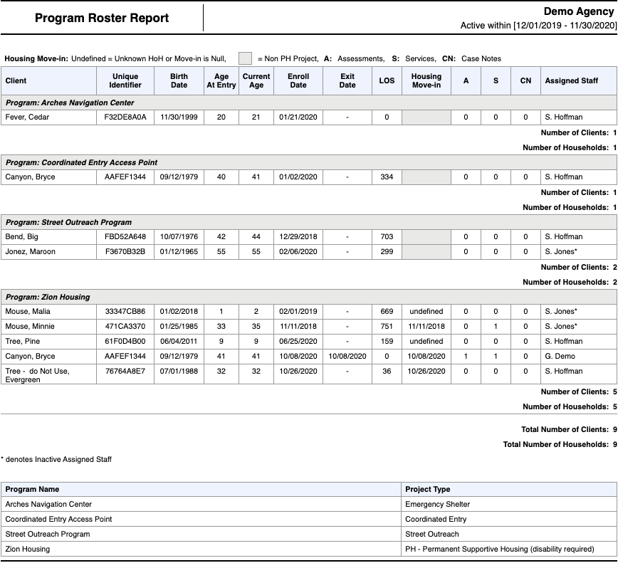
Program Roster
Confidential and Proprietary | © 2022 Bitfocus Inc., All Rights Reserved

Slide 14
HMIS Data Quality Report
[HUDX-225] HMIS Data Quality Report (HUD Reports)
Who needs support around data entry?
Part of HUD’s Data Quality Framework
Comprehensive data review
Confidential and Proprietary | © 2022 Bitfocus Inc., All Rights Reserved

Slide 15
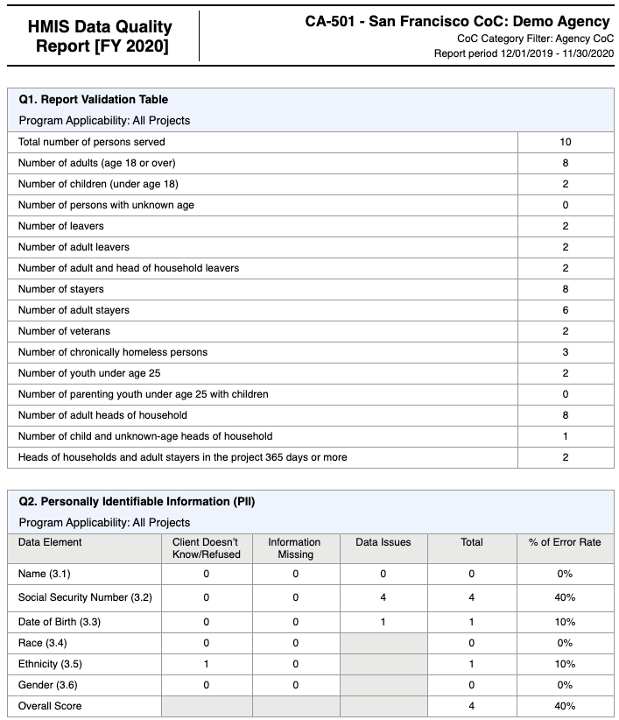
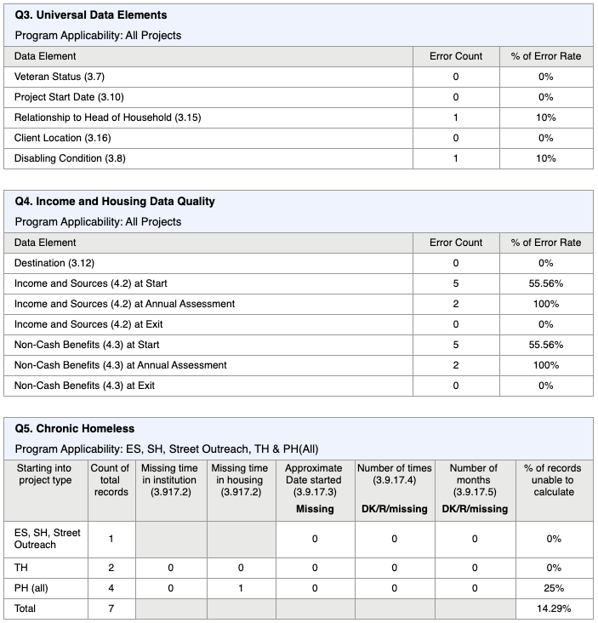
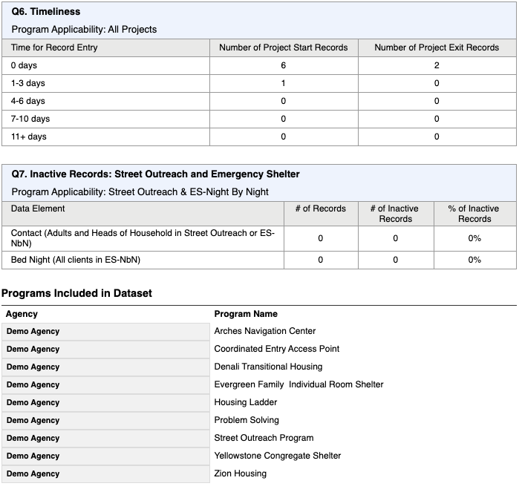
HMIS Data Quality Report
Confidential and Proprietary | © 2022 Bitfocus Inc., All Rights Reserved

Slide 16
Generating the APR
Confidential and Proprietary | © 2022 Bitfocus Inc., All Rights Reserved
Notes:
Now that you’ve been prepping for your submission, now it’s time to generate the APR.

Slide 17
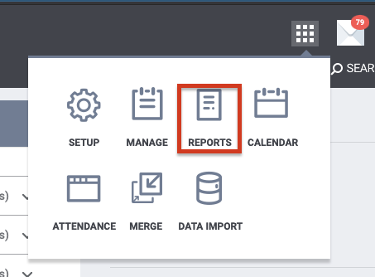
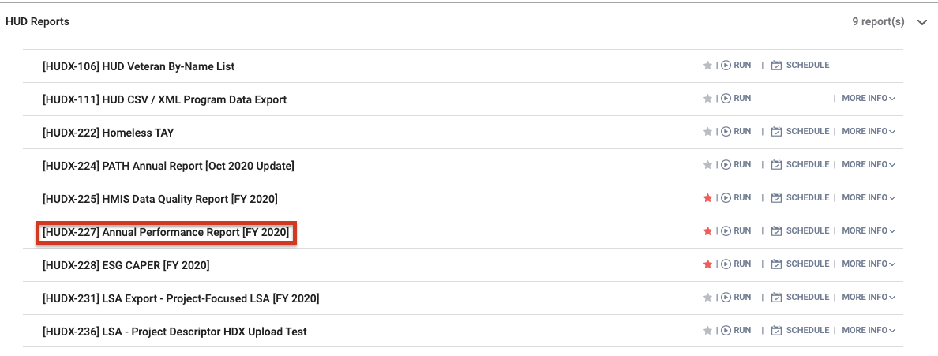
Generating the APR
To generate a draft or final APR in:
Open the launcher
Select ‘Reports’
Scroll to ‘HUD Reports’
Select ‘HUDX-227’ Annual Performance Report [FY 2020]
Select Run
Enter Parameters
Confidential and Proprietary | © 2022 Bitfocus Inc., All Rights Reserved

Slide 18
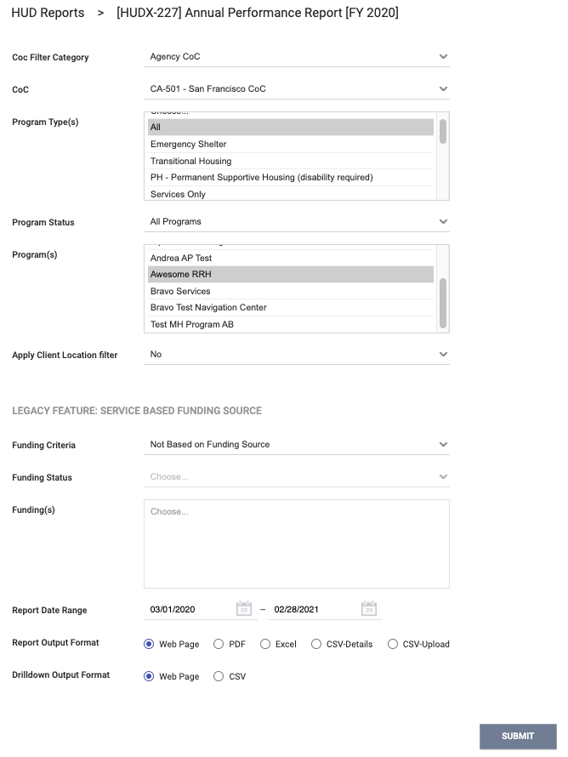
Generating the APR
Review the report results closely in an effort to identify any issues with the data. Upon making corrections to the data as needed, feel free to re-run the report to verify the corrections are reflected in the report results.
Confidential and Proprietary | © 2022 Bitfocus Inc., All Rights Reserved

Slide 19
APR Data Elements
Confidential and Proprietary | © 2022 Bitfocus Inc., All Rights Reserved
Notes:
Now that you’ve been prepping for your submission, now it’s time to generate the APR.

Slide 20
APR Data Elements: Reports
APR contains over 60 data elements:
Overall counts from latest project stay from report period
Specific data about Chronic Homelessness and Fleeing DV
Specific data about Stayers and Leavers
Data quality/missing data information, similar to sections of [HUDX-225] HMIS Data Quality Report
Confidential and Proprietary | © 2022 Bitfocus Inc., All Rights Reserved

Slide 21
APR Data Elements
What You Will See
Report Name
Agency Name
Report Period Dates
CoC Category Filter
Client Location Filter
Limits to only include those households from the selected CoC(s) at project entry
Confidential and Proprietary | © 2022 Bitfocus Inc., All Rights Reserved

Slide 22
Question 4 a: Project Identifiers
Agency Name & HMIS ID
Program Name & HMIS ID
HMIS Project Type Code
For ES: Night-by-Night or Entry/Exit Tracking Code
For Services Only: affiliations with residential types
CoC
Geocode
HMIS software name
Report start and end date
Number of clients enrolled
Confidential and Proprietary | © 2022 Bitfocus Inc., All Rights Reserved

Slide 23
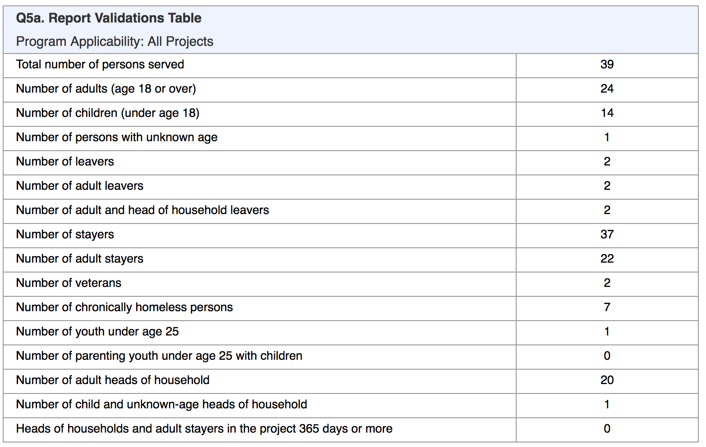
Question 5a: Report Validation Table
How many total clients did we serve, in which categories?
Leavers - exited as of last day of report date range
Stayers - active on last day of report date range
Youth - age 12-24 HoH (Head of Household)
Chronically Homeless at entry
Disabling condition + 1 year continuous homeless
Disabling condition + 4 episodes homeless totally at least 12 months in past 3 years
Confidential and Proprietary | © 2022 Bitfocus Inc., All Rights Reserved

Slide 24
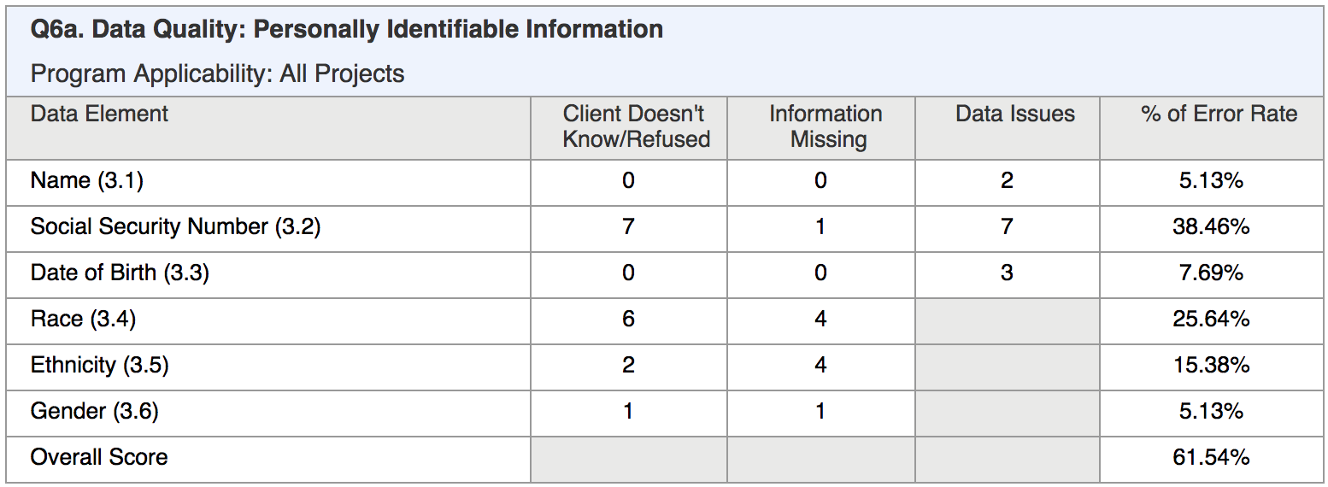
Question 6a: Data Quality Personally Identifiable Info.
How much PII and/or demographic data are we missing?
Client doesn't know/Refused
Information Missing: Data not Collected/Null/Blank
Data Issues:
Partial Name Quality Field
SSN less than 9 digits, “0000”, etc.
DOB partial, before 1915, after record created, etc.
Confidential and Proprietary | © 2022 Bitfocus Inc., All Rights Reserved

Slide 25
Question 6b: Universal Data Elements
What errors are showing for other Client Profile data?
Client doesn't know/Refused/Missing
Overlapping dates in same project
HoH data conflicts
Conflict where Disabling
Condition =No, but type of Condition =Yes
Confidential and Proprietary | © 2022 Bitfocus Inc., All Rights Reserved

Slide 26
Question 6c: Income and Housing
Errors include:
◦ Income or Destination = Client doesn’t know/Refused/Data not collected/Missing
◦ Contradiction between Income Yes/No and Income Source details
Confidential and Proprietary | © 2022 Bitfocus Inc., All Rights Reserved

Slide 27
Question 6d: Chronic Homeless Data
Count of active adults/HoH who enrolled during the report range
Count of enrollments missing Living Situation questions
% of enrollments that cannot be used to calculate CH
Transfers from PH or TH will not be calculated towards this
Is anything missing that may be needed to identify a client as “chronically homeless?”
Confidential and Proprietary | © 2022 Bitfocus Inc., All Rights Reserved

Slide 28
Questions 6e/6f: Timeliness/Inactive Records
How long are we taking to enter enrollments and exits into HMIS?
Days between project start or exit date and the timestamp
Real-time data entry is encouraged
No Contact or Bed Night within 90 days since entry or last Contact/Bed Night
How many Street Outreach or NBN Shelter clients are inactive and need an update or exit?
Confidential and Proprietary | © 2022 Bitfocus Inc., All Rights Reserved

Slide 29
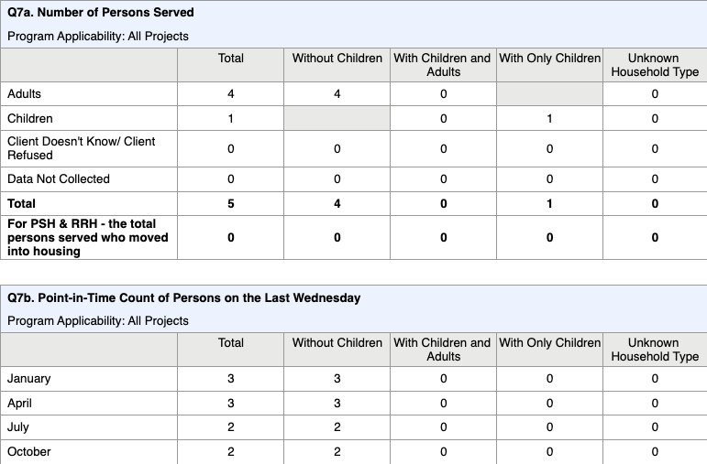
Questions 7a/7b: Persons Served
How many adults and children did we serve overall, and on the HUD PIT dates?
Count of Persons in households with and without children
Point-In-Time date counts include all project types
Confidential and Proprietary | © 2022 Bitfocus Inc., All Rights Reserved

Slide 30
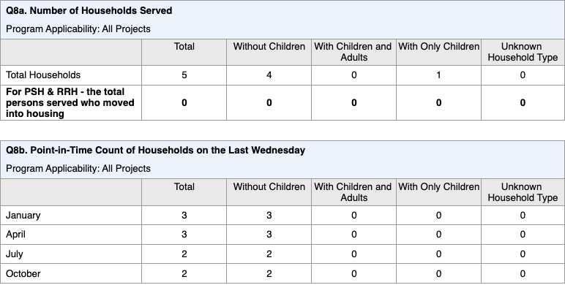
Questions 8a/8b: Households Served
Count of households with and without children
For PSH/RRH, includes number of persons in housing
Point-In-Time date counts include all project types
Both include a household type breakdown
How many households did we serve overall, and on the HUD PIT dates?
Confidential and Proprietary | © 2022 Bitfocus Inc., All Rights Reserved

Slide 31
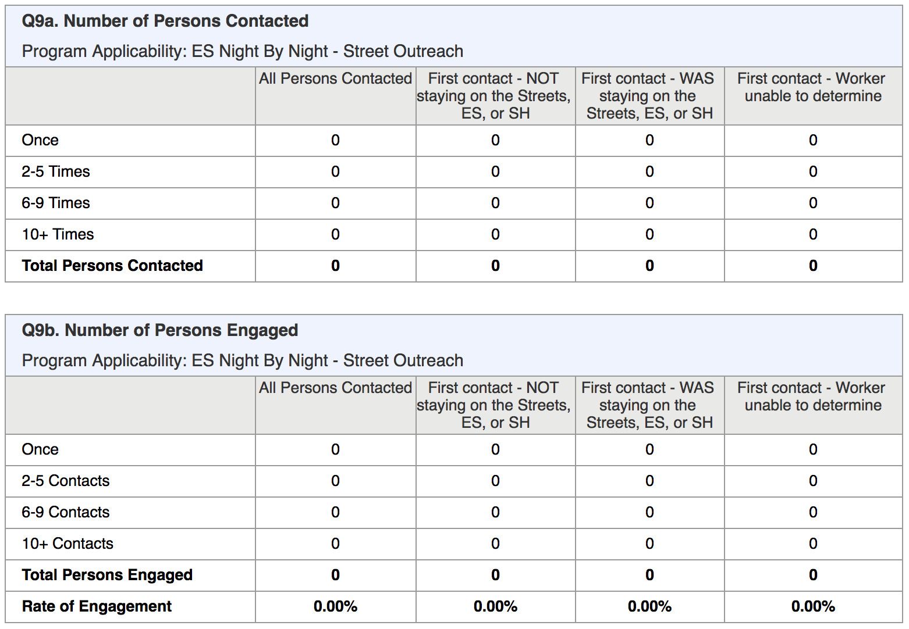
Questions 9a/9b: Contacted and Engaged
Applies to Night-by-Night Emergency Shelter and Street Outreach only
Applies to Adults/HoH only
“Contacted” means contact service, bed night, or date of engagement
“First contact” is first contact within the report date range
Persons Engaged table only includes clients with an Engagement Date
Rate = Total Contacted (Q9a) / Total Engaged (Q9b)
How many clients were we in contact with and what was their status as first contact?
Confidential and Proprietary | © 2022 Bitfocus Inc., All Rights Reserved

Slide 32
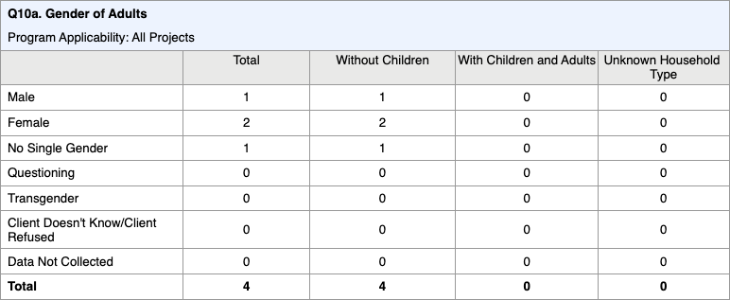
Questions 10a/10b/10c: Gender
Shows totals in each gender category
Includes household type breakdown
Separate tables for Adults, Children, and Missing Age
Unknown Household Type often results from missing DOB
What is the gender breakdown of our client population?
Confidential and Proprietary | © 2022 Bitfocus Inc., All Rights Reserved

Slide 33
Questions 11/12a/12b: Age/Race/Ethnicity
What is the breakdown of our client population by age, race and ethnicity?
Shows totals in each category (age, race, ethnicity)
Includes household type breakdown
Very young child-only households may be indicator of data quality issue (12a only)
Unknown Household Type often results from missing DOB
Confidential and Proprietary | © 2022 Bitfocus Inc., All Rights Reserved

Slide 34
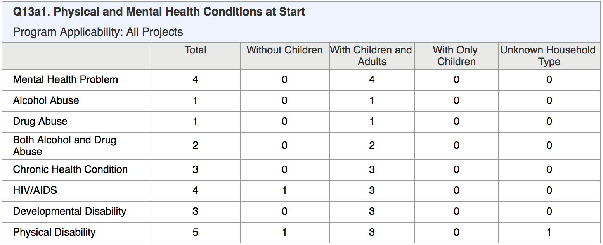
Questions 13a1/13b1/13c1: Condition Types
Shows totals in each condition category
Household type breakdown
Includes physical, mental health conditions
Reflected at Start, Exit, and Latest update (for Stayers)
What physical and mental health conditions did our clients have throughout their enrollment?
Confidential and Proprietary | © 2022 Bitfocus Inc., All Rights Reserved

Slide 35
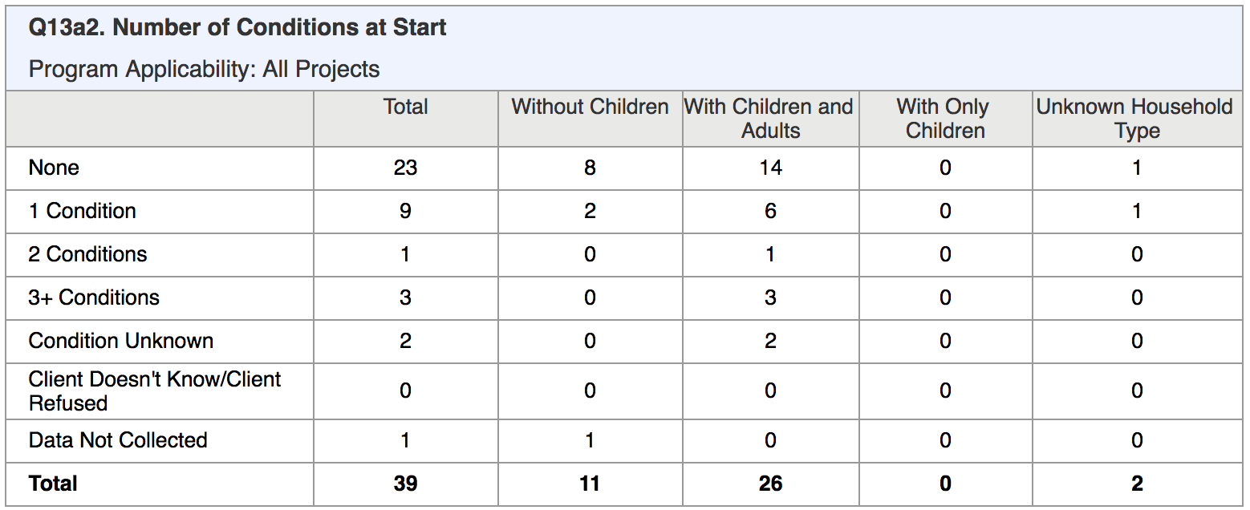
Questions 13a2/13b2/13c2: Count of Conditions
Shows totals in each count category
Household types breakdown
Reflected at Start, Exit, and Latest update (for Stayers)
How many conditions did each of our clients have at project entry, project exit, or based on most recent information available if enrollment still active?
Confidential and Proprietary | © 2022 Bitfocus Inc., All Rights Reserved

Slide 36
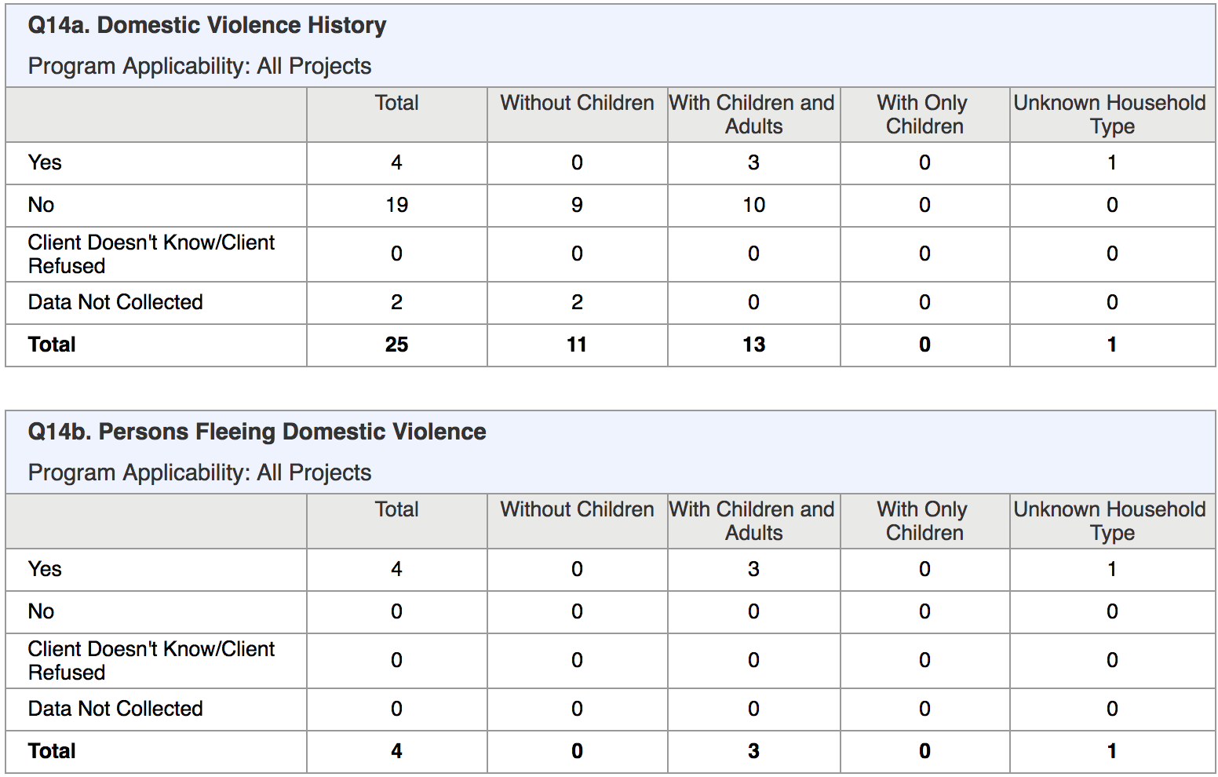
Questions 14a/14b: Domestic Violence History & Fleeing
Count of all Adults/HoH indicating survivor of domestic violence and/or those who were also fleeing at project entry
How many of our clients reports a history of domestic violence?
How many of our clients are actively fleeing?
Confidential and Proprietary | © 2022 Bitfocus Inc., All Rights Reserved

Slide 37
Question 15: Living Situation
Count of all Adults/HoH within each category:
Homeless Situation
Institutional Setting
Other
Related to Chronic Homeless status
Shows household types that make up the total
What situations were our clients living in immediately prior to entering our project?
Confidential and Proprietary | © 2022 Bitfocus Inc., All Rights Reserved

Slide 38
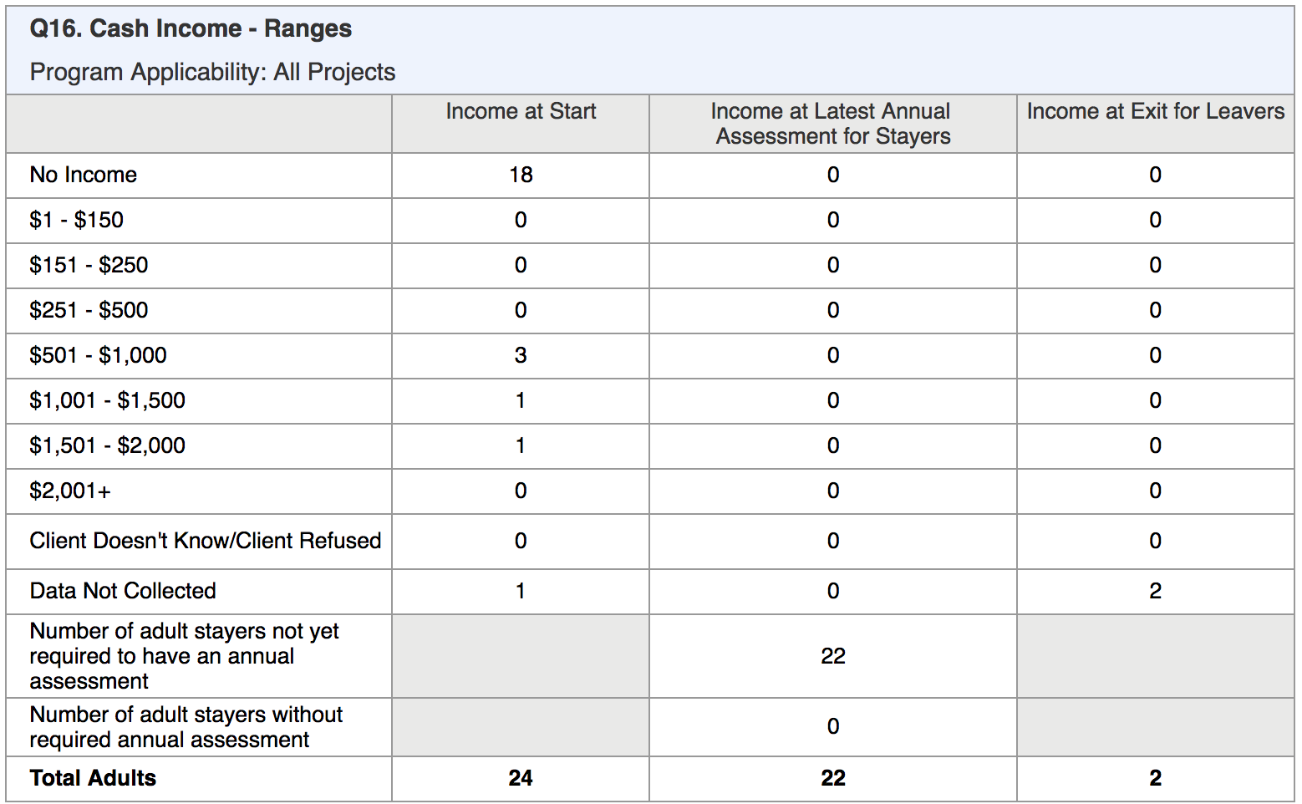
Question 16: Cash Income Ranges
How much monthly income were our adult clients receiving at project entry, exit, or as reported on their latest annual update in HMIS?
Count of all Adults within each category
Sum of column equals Total at bottom and matches counts on first Report Validation Table for
Adults
Adult Stayers
Adult Leavers
Stayers 365+
Confidential and Proprietary | © 2022 Bitfocus Inc., All Rights Reserved

Slide 39
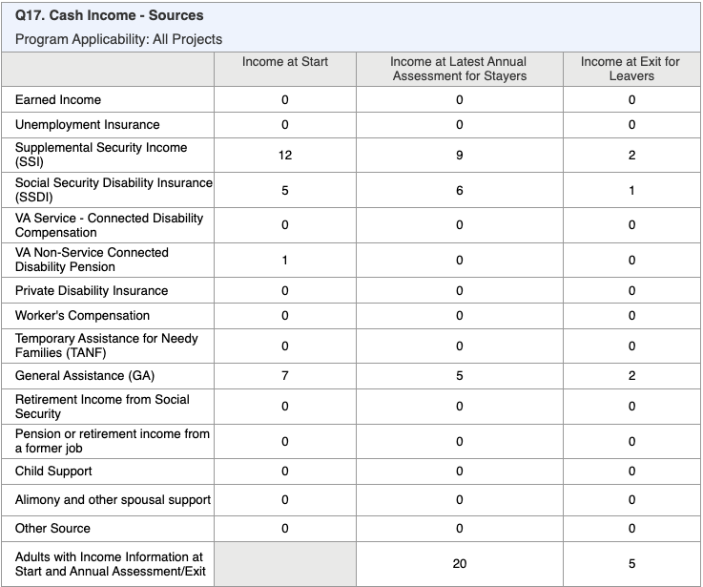
Question 17: Cash Income - Sources
Count of all Adults within each income source category at Start/Annual/Exit
Bottom row shows count of adults that had income sources throughout their entire stay (Start → Annual Assessment → Exit Income)
Confidential and Proprietary | © 2022 Bitfocus Inc., All Rights Reserved

Slide 40
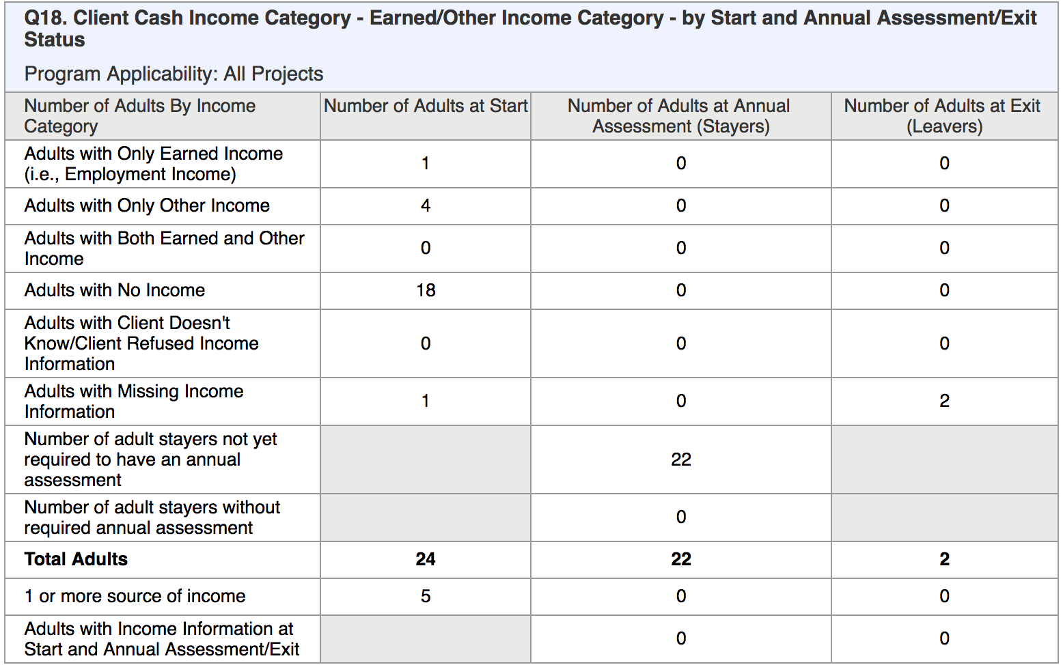
Question 18: Cash Income by Start/Annual/Exit
How many adult clients have “earned” vs. “other” type of income vs. none/missing?
Count of all Adults within each source category at Start/Annual/Exit
Bottom rows shows counts of adults that have more than one source to compare:
Start → Annual Update Income
Start → Exit Income
Confidential and Proprietary | © 2022 Bitfocus Inc., All Rights Reserved

Slide 41
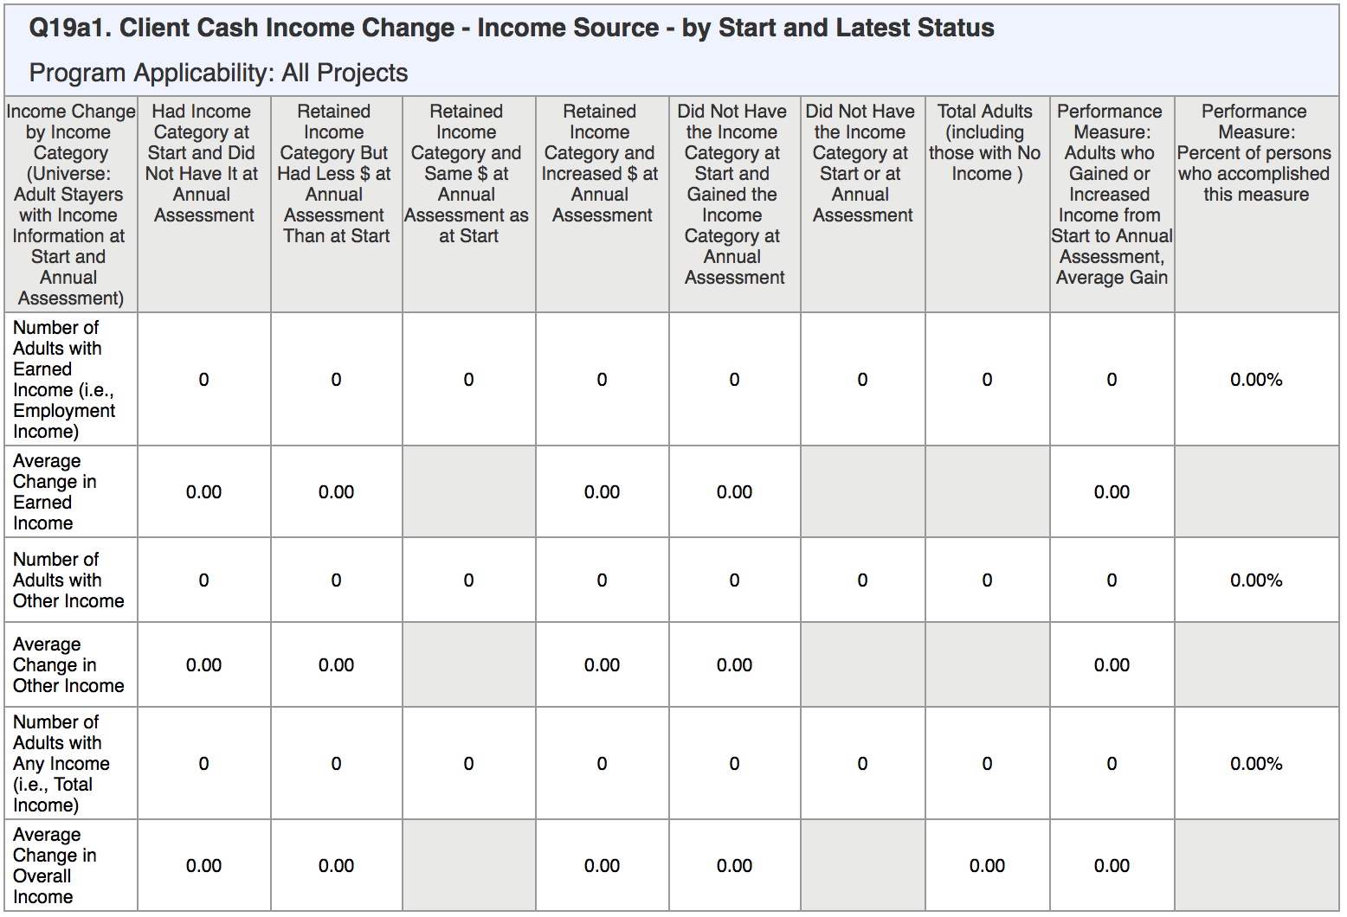
Questions 19a1/19a2: Income Change
Count of Adults with “earned” and “other” income in each category re: retention and type
Shows income changes between:
Start → Annual Update
Start → Exit
Start → Annual/Exit
Calculates the average change across the group of clients that fit the category
How many adult clients have had a change in income amount or type of income over time? How much has their income changed?
Confidential and Proprietary | © 2022 Bitfocus Inc., All Rights Reserved

Slide 42
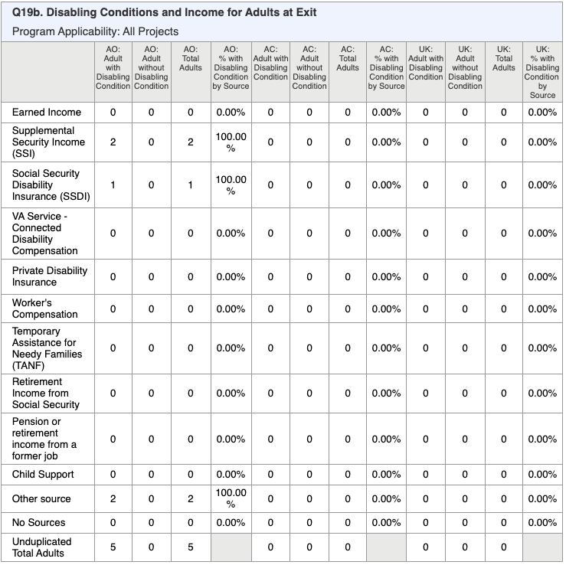
Questions 19b: Disabling Conditions and Income at Exit
Count of Adults with or without disabling conditions and their income source
Calculates the percentages across each group of clients that fit within the category
Confidential and Proprietary | © 2022 Bitfocus Inc., All Rights Reserved

Slide 43
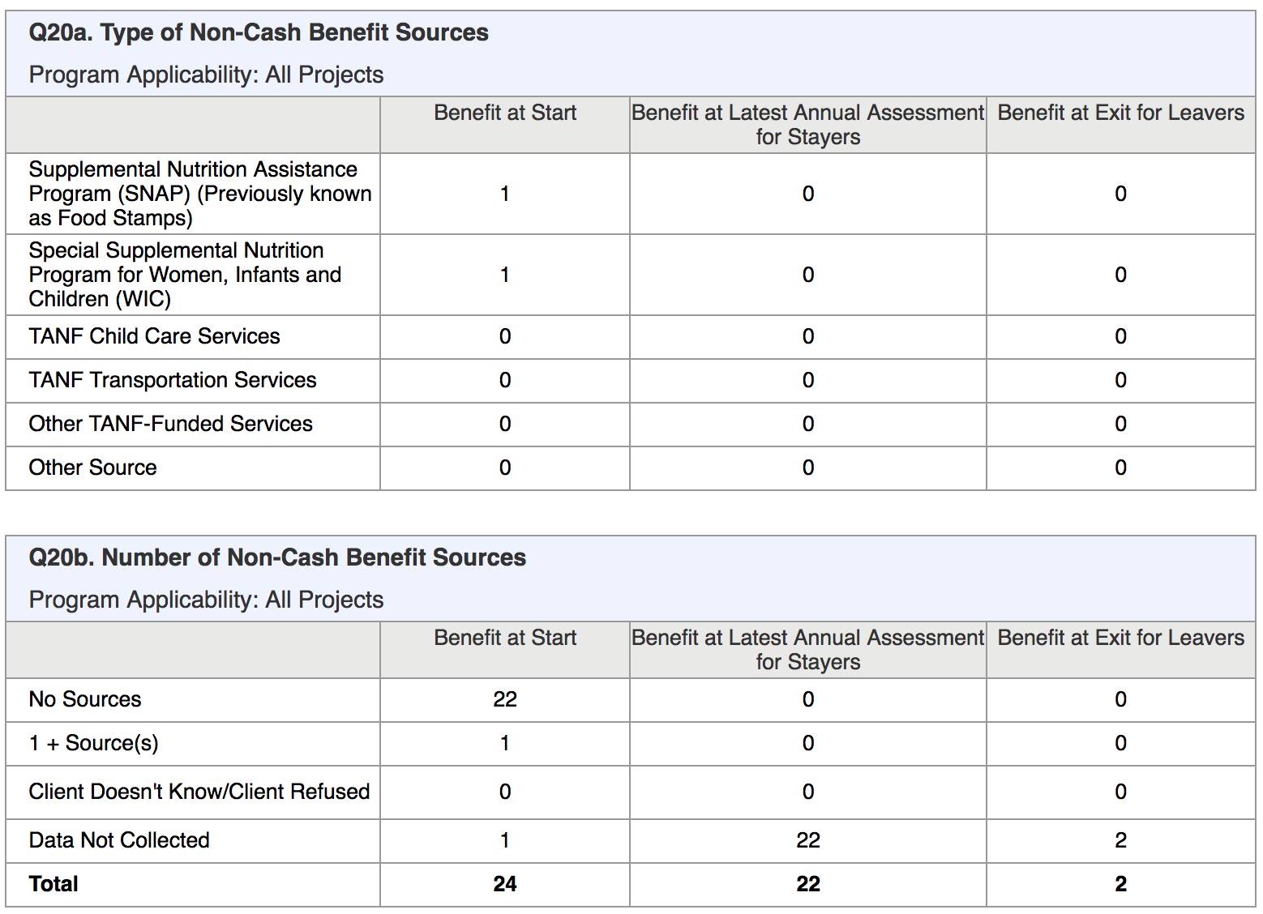
Questions 20a/20b: Non-Cash Benefit Sources
Count of Adults for each type of benefit and number of benefit sources
Separate counts at project entry, annual update, and exit
Leavers: HoH who left plus other adult household members who left at the same time
What types of non-cash benefits do our adult clients receive? How many non-cash benefits do our clients receive?
Confidential and Proprietary | © 2022 Bitfocus Inc., All Rights Reserved

Slide 44
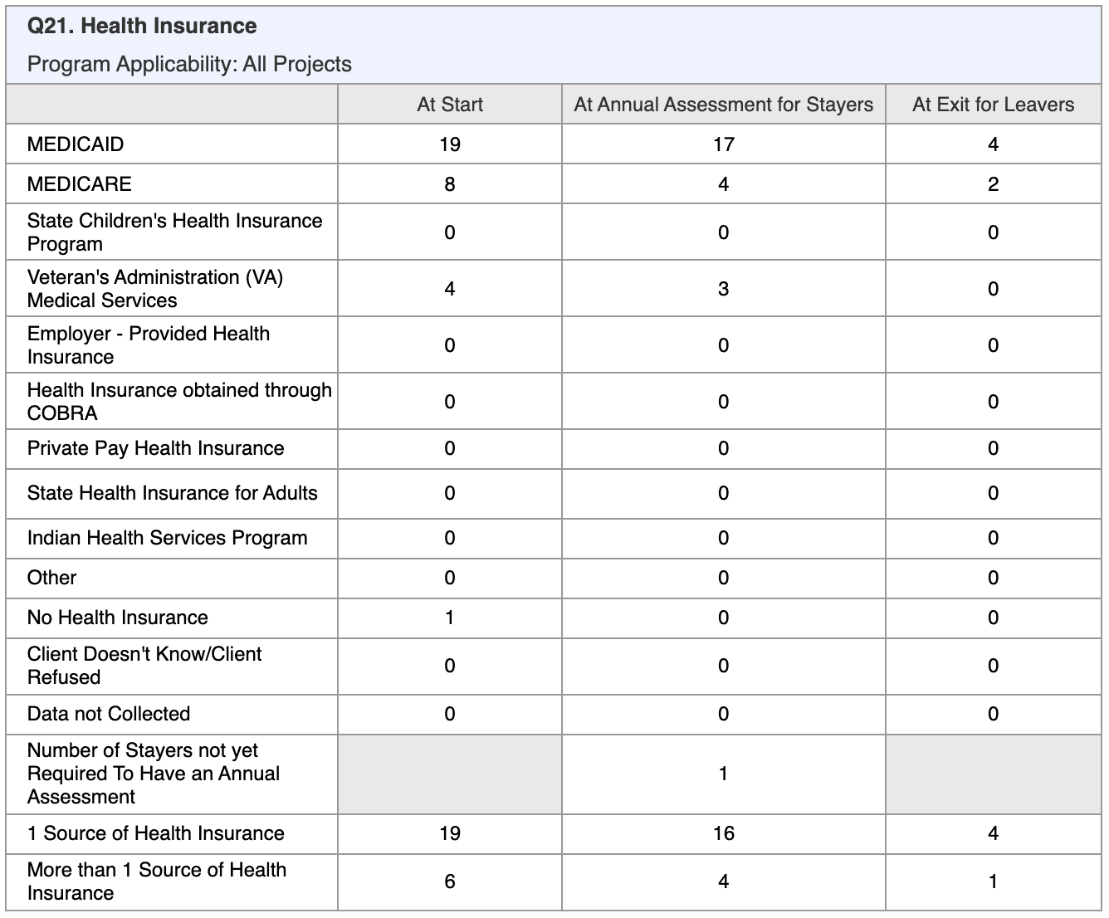
Question 21: Health Insurance
What type of health insurance do our clients have?
Count of all clients within each source category at Start/Annual/Exit
Bottom rows shows counts of clients who have only one source vs. more than one source at Start/Annual/Exit
Confidential and Proprietary | © 2022 Bitfocus Inc., All Rights Reserved

Slide 45
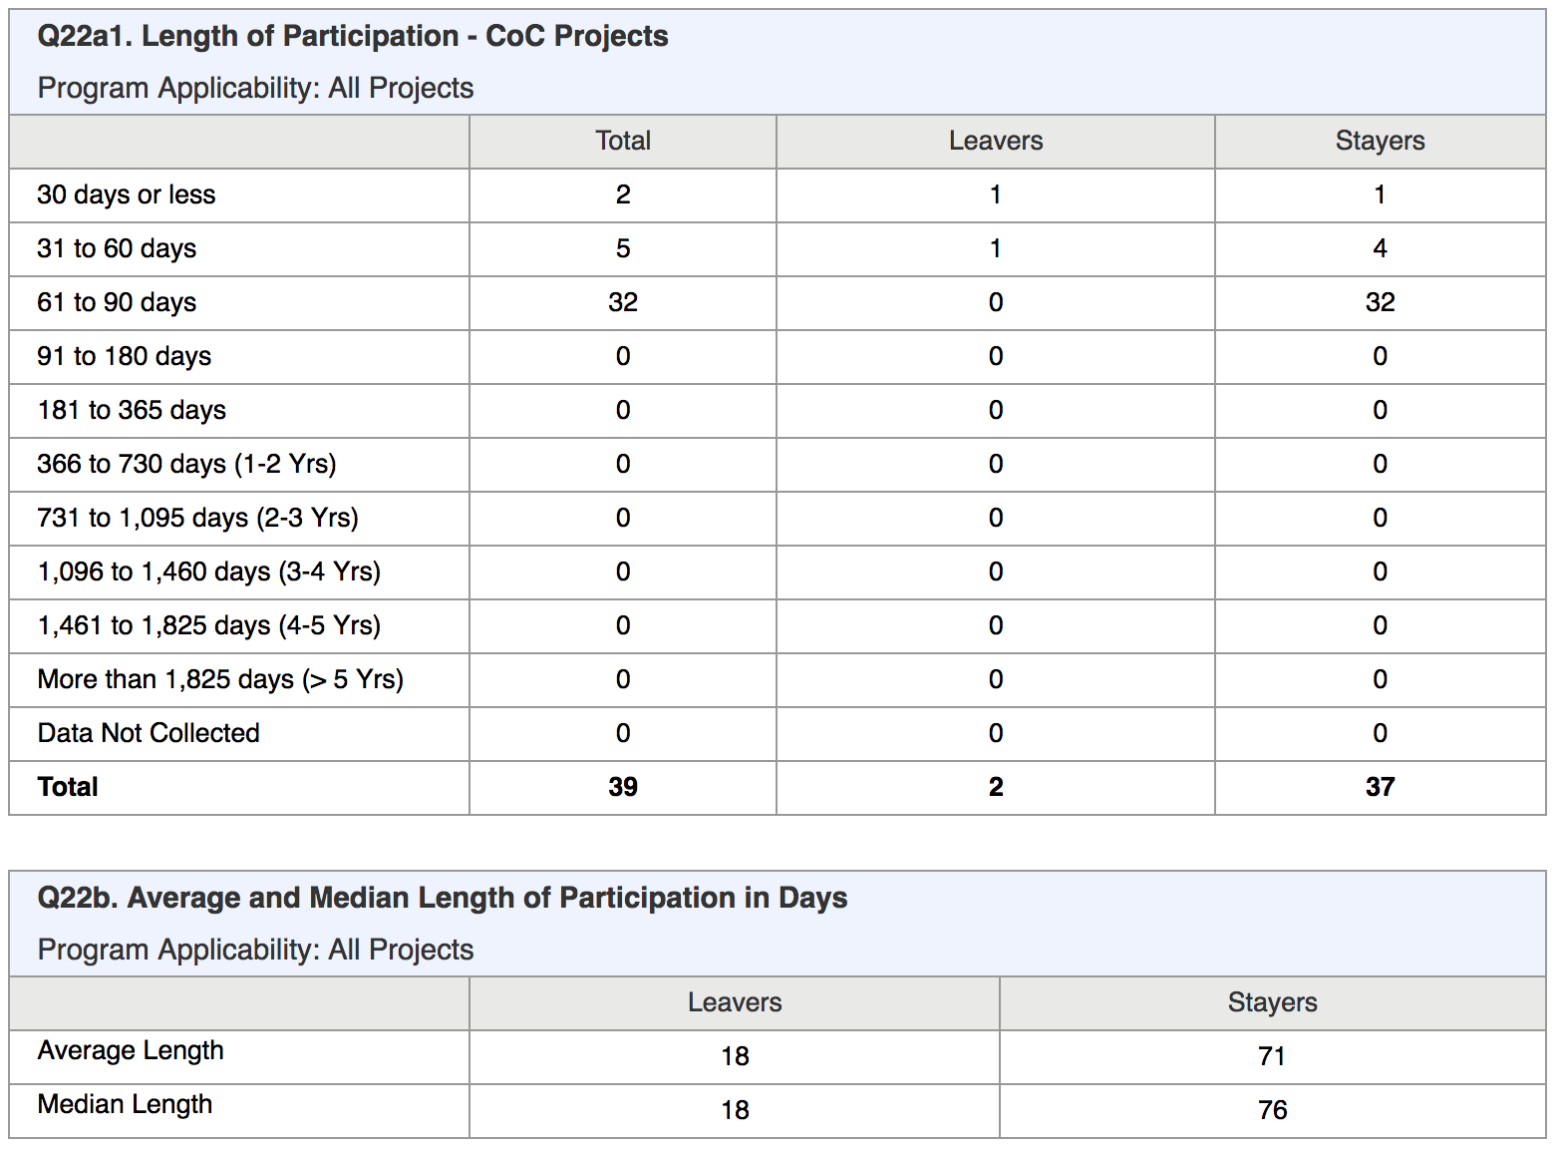
Questions 22a1/22b: Length of Participation
How long did our clients participate in our program?
What is the average number of days in our program for clients who exited vs. clients still participating?
Count of all clients active during report period, categorized by range of days
Shows ranges for Total/Leavers/Stayers
Includes full time in latest project stay, even if project entry before start of report start date
Confidential and Proprietary | © 2022 Bitfocus Inc., All Rights Reserved

Slide 46
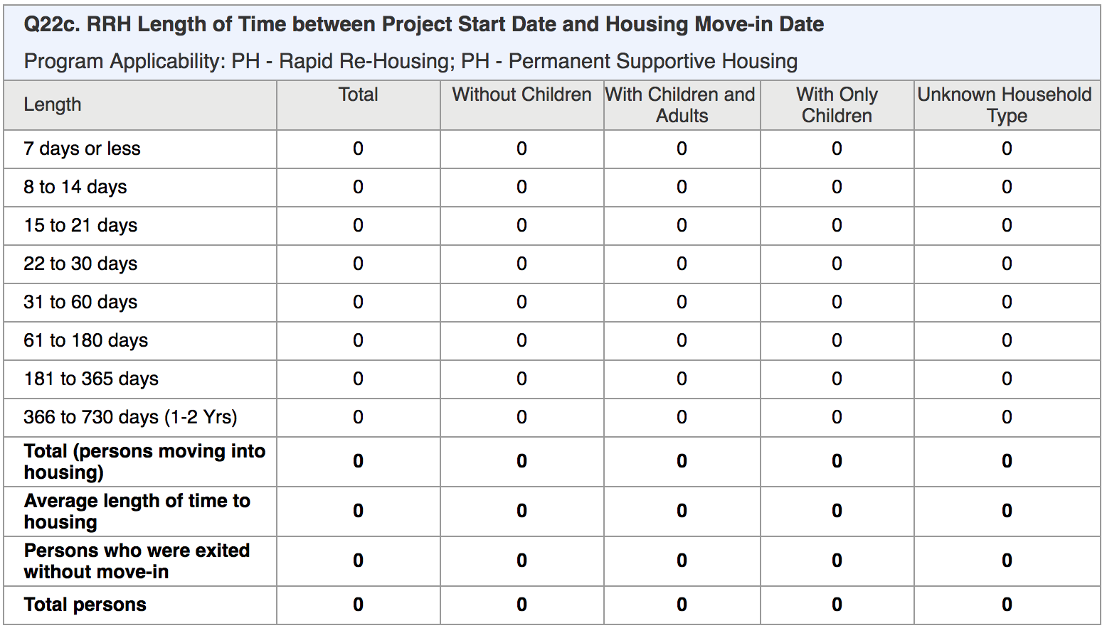
Question 22c: RRH Time Between Start & Move-In
How long between when our clients entered our RRH program and the time the clients moved into housing?
Count of all clients active during report period, categorized by range of days between project Start Date and Housing Move-in Date
Looks at LOT before move-in
Shows breakdown by household type
Confidential and Proprietary | © 2022 Bitfocus Inc., All Rights Reserved

Slide 47
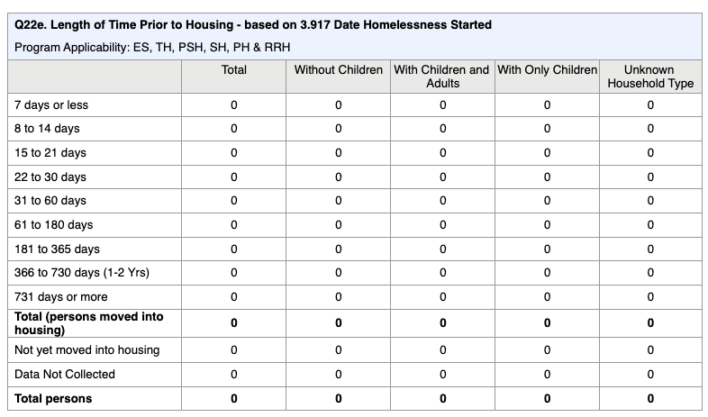
Question 22e: Length of Time Prior to Housing
How long between when our clients entered our program and the time the clients moved into housing?
Similar to 22c but now includes ES, TH, PSH, SH and PH-RRH
Looks at Length of Time homeless before move-in
Confidential and Proprietary | © 2022 Bitfocus Inc., All Rights Reserved

Slide 48
Where do clients go when they leave our program?
Question 23c: Exit Destination
Counts all clients with exit date in report range, broken down by household type.
Shows Permanent, Temporary, Institutional, and Other Destinations.
Performance Outcomes:
Total clients exiting to positive destination
% of clients exiting to positive destinations
“Positive destination” = permanent, with additional positive destinations to temp/institutions for Street Outreach projects
Confidential and Proprietary | © 2022 Bitfocus Inc., All Rights Reserved

Slide 49
Special Populations
Section 25-27: Veterans, Chronically homeless & Youth
Population specific details
Includes the same general data points as the broader sections
Age
Gender
Disability information
Income
Sources of Income
Exit destinations
Confidential and Proprietary | © 2022 Bitfocus Inc., All Rights Reserved
Notes:
Question 25(a-i) are similar to previous data elements, but with a focus on Veterans and Veteran Households:
Veterans: a client is counted as a Veteran when the client is an adult (age 18+) and when Veteran Status = Yes
Veteran Households: a household is considered a Veteran Household when any of the adults in the household has Veteran Status = Yes (for HoH’s latest project stay in report range)
Elements include:
Counts of Chronically Homeless Veterans and CH Vet Households
Gender, Age, Conditions, Cash Income Type/Change, Benefits Type/Change, and Exit Destination

Slide 50
Correcting Data
Confidential and Proprietary | © 2022 Bitfocus Inc., All Rights Reserved

Slide 51
How to Correct Data
Use report results to target what needs to be corrected (run as webpage for drill-down)
Navigate to the Client’s Profile or Program Enrollment to make corrections, depending on what needs to be corrected.
◦ Client Profile: DOB, SSN, Veteran details, demographics, etc.
◦ Enrollment: Living Situation, Disability, Income, Domestic Violence, etc.
◦ Annual Assessment: Income/benefit increases
◦ Exit: Destination, Income/benefit increases, etc.
Update households by navigating to program-level household management.
◦ All HH members should be enrolled together with the appropriate assigned relationships
◦May also need to adjust global household on the Client Profile screen.
Confidential and Proprietary | © 2022 Bitfocus Inc., All Rights Reserved

Slide 52
Pro Tips
Confidential and Proprietary | © 2022 Bitfocus Inc., All Rights Reserved

Slide 53
Pro Tips
Avoid using “Client doesn’t know”, “Client refused”, “Data not collected”
Use the webpage output format to help identify data corrections with drill down functionality
Correct data as much as possible and re-run the report to check progress
Everyone has a role in maintaining Data Quality!
Confidential and Proprietary | © 2022 Bitfocus Inc., All Rights Reserved

Slide 54
Resources
Slides/training materials can be found here: https://www.cafth.org/hmis-resources/
Additional questions, please contact the HMIS Help Desk at helpdesk@cafth.org
HUD: Continuum of Care APR
APR Report Programming & Specifications
APR Bitfocus Help Center Article
Confidential and Proprietary | © 2022 Bitfocus Inc., All Rights Reserved

Slide 55
Questions & Comments?
Confidential and Proprietary | © 2022 Bitfocus Inc., All Rights Reserved

